Slide 1
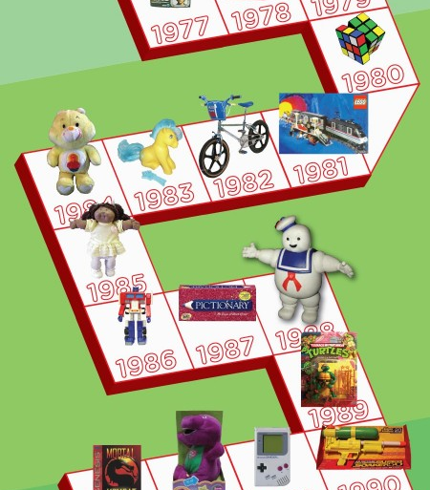
Toys over time

Slide 2
How have toys changed over time?
Toys have changed over time. There are many differences between toys from the past and present.

Slide 3
How do we find out about the toys in the past?
Ask parents and grandparents
Visit a museum
Research on the internet

Slide 4
Parents/grandparents/older relative interview
What toys did you have as a child?
Wat was your favourite toy? Why?
Was there a toy you wished you could have had?
What do you think about today’s toys?
Which toy from your childhood you think I could have lots of fun playing with?

Slide 5
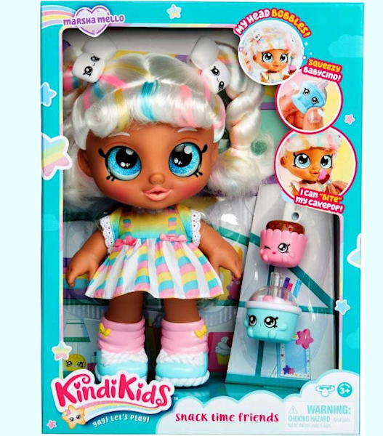
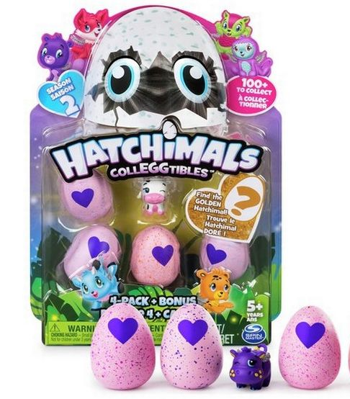
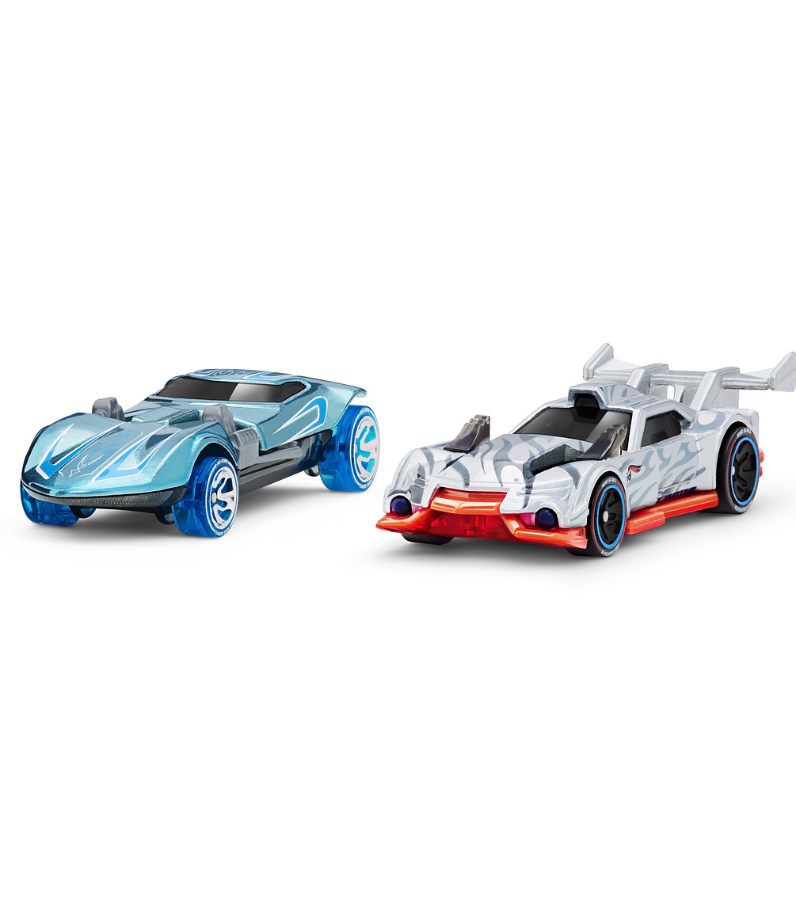
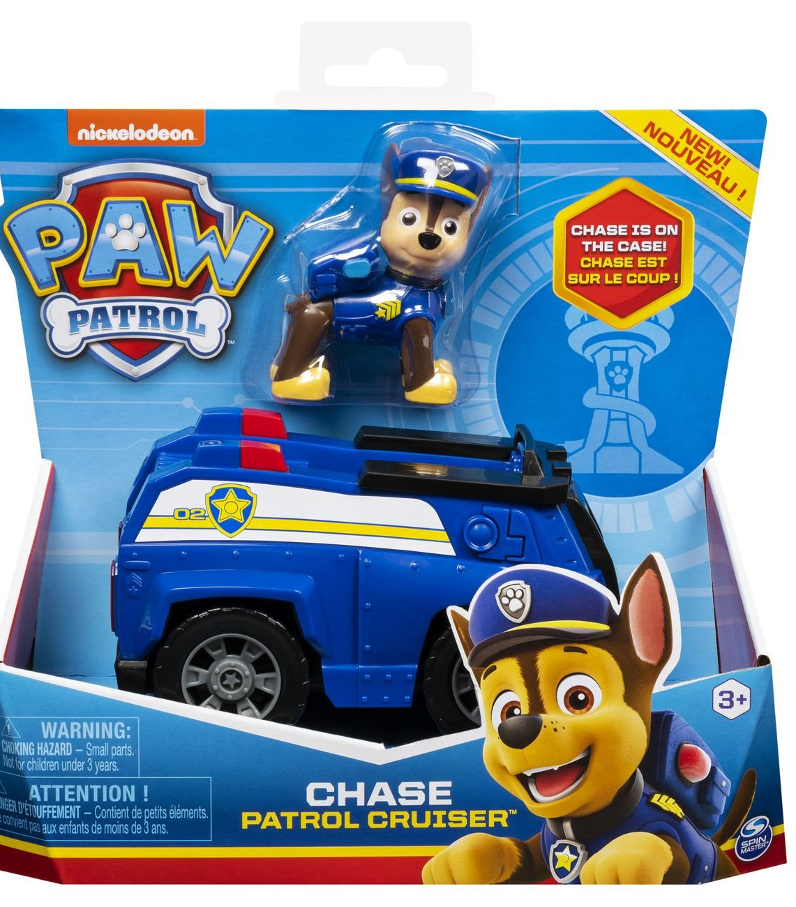
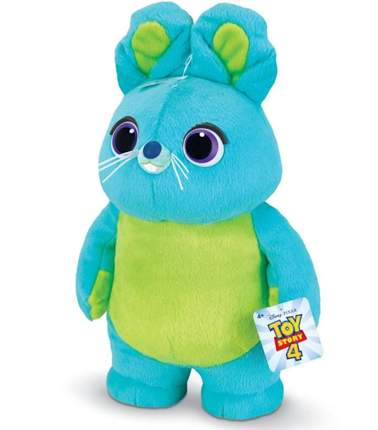
Describe your own toys
What are made of?
How do they work?
Does they move? How?
Does they need batteries?
What else can they do?

Slide 6
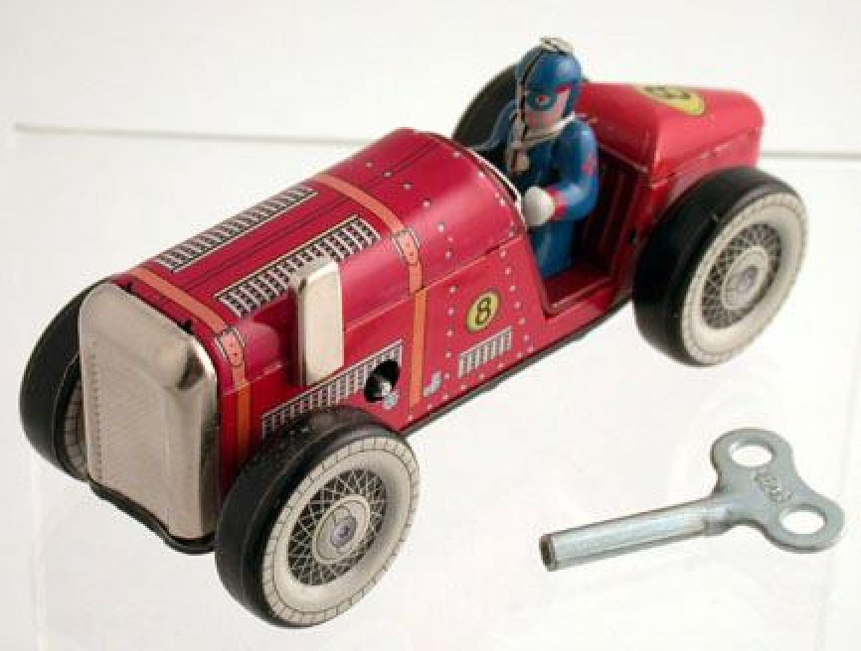
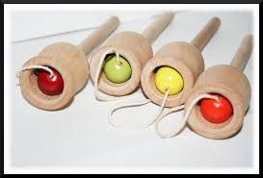
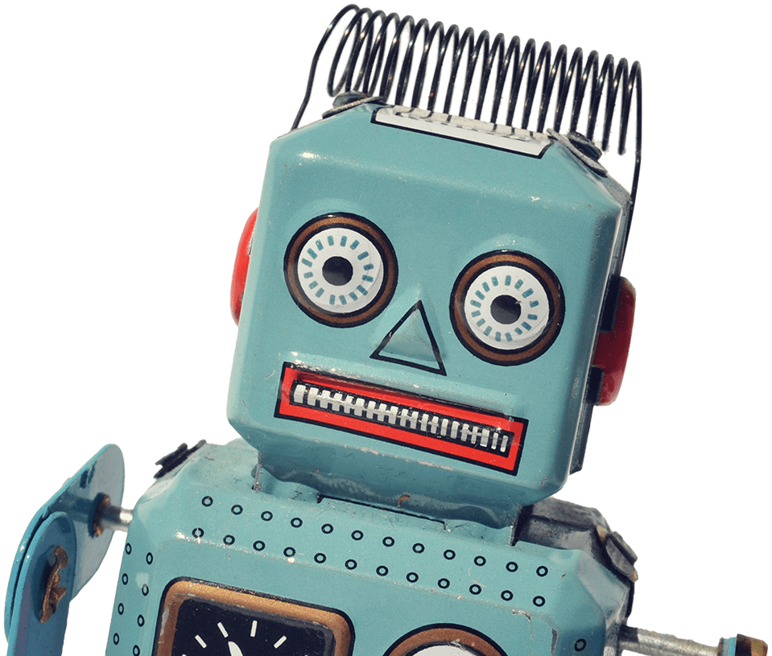
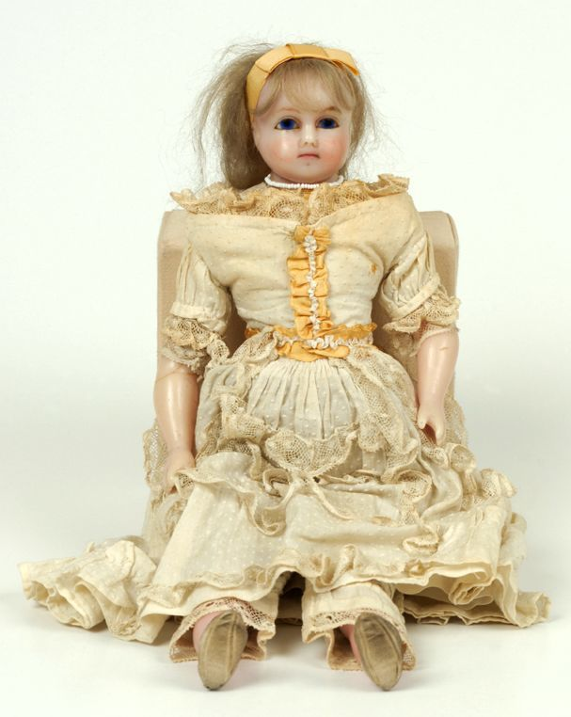
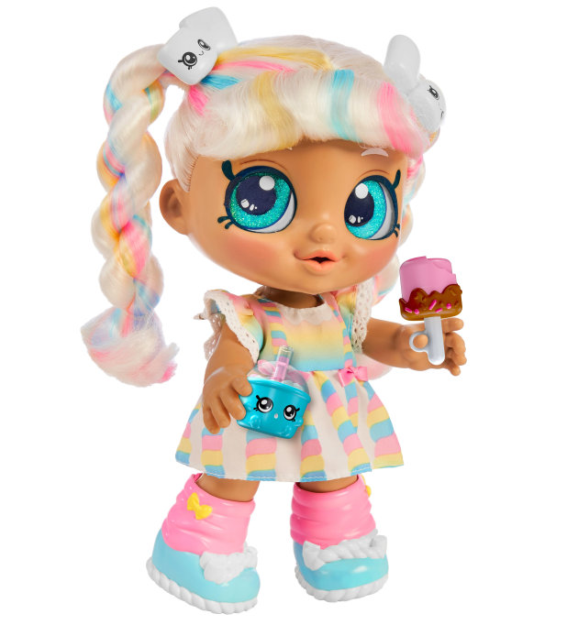
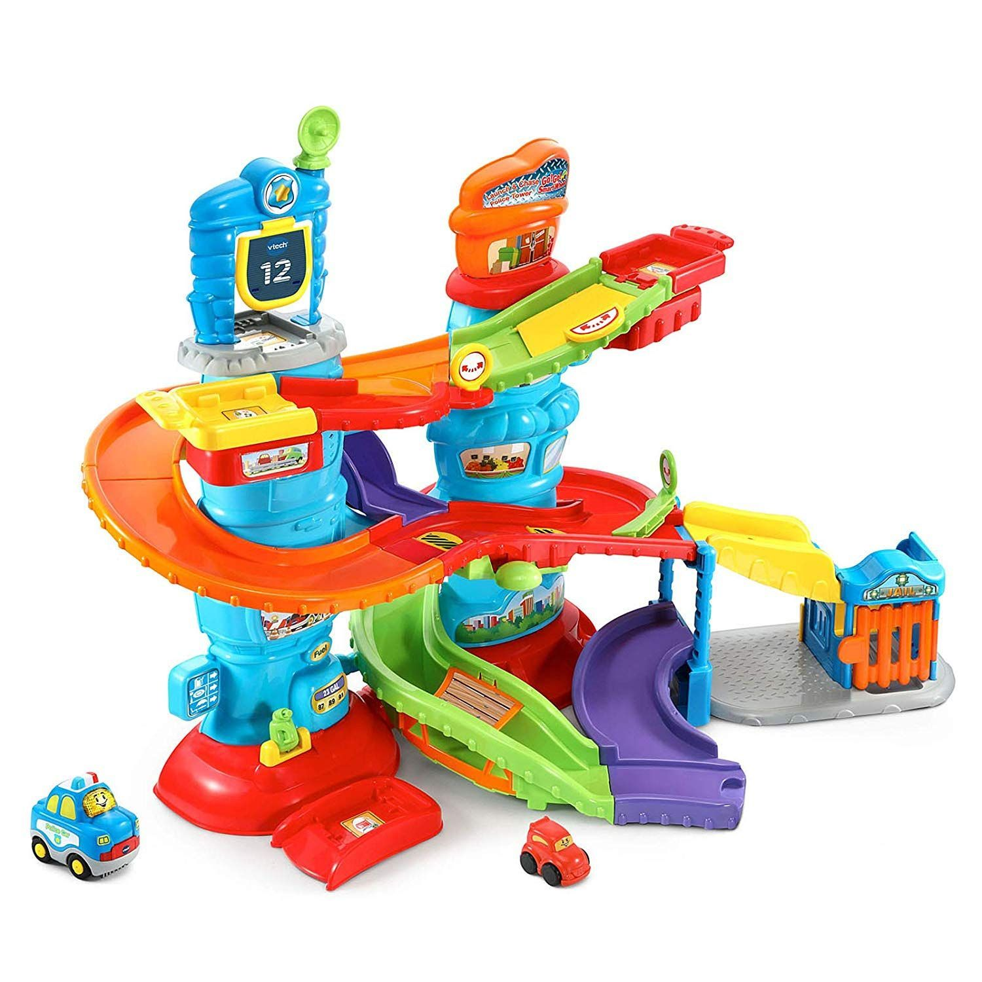
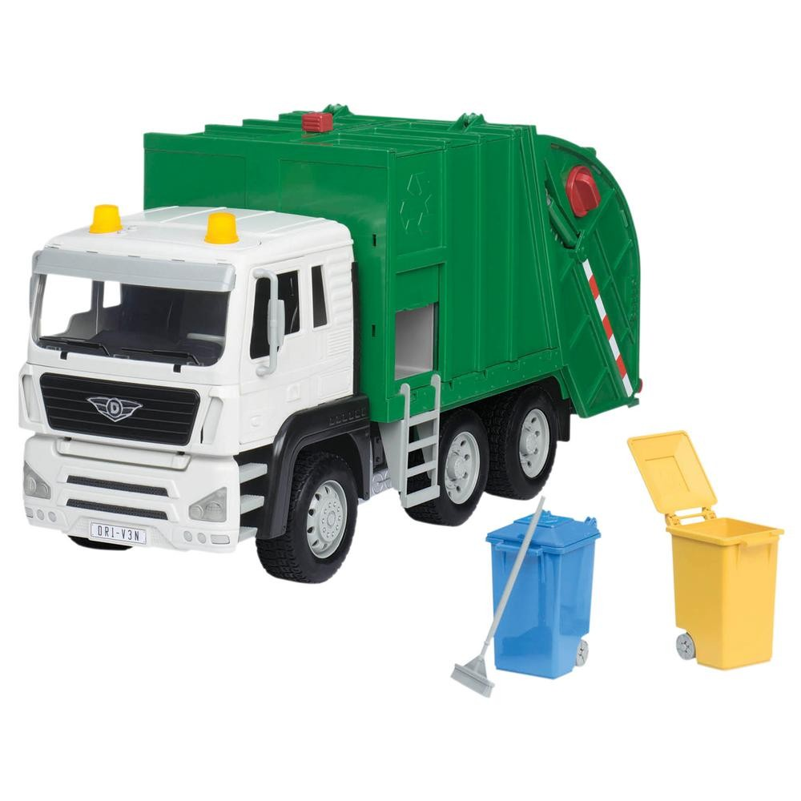
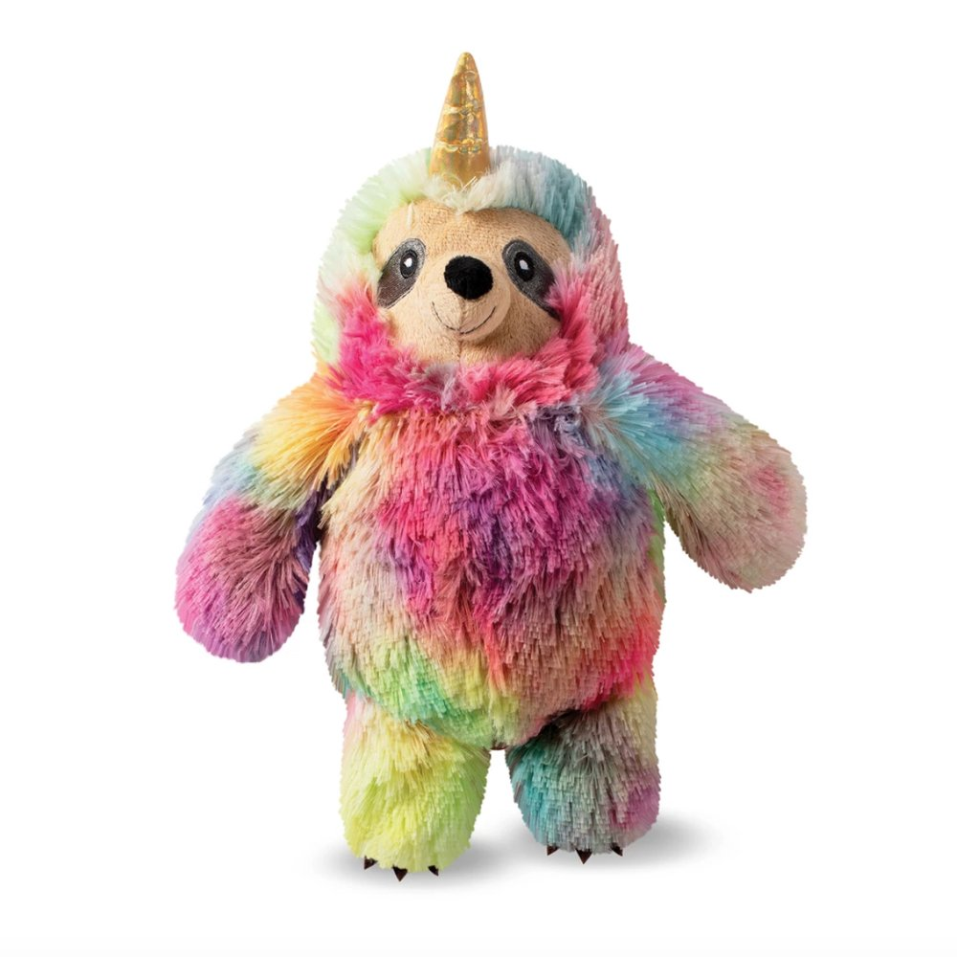
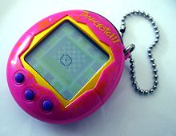
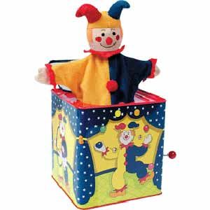
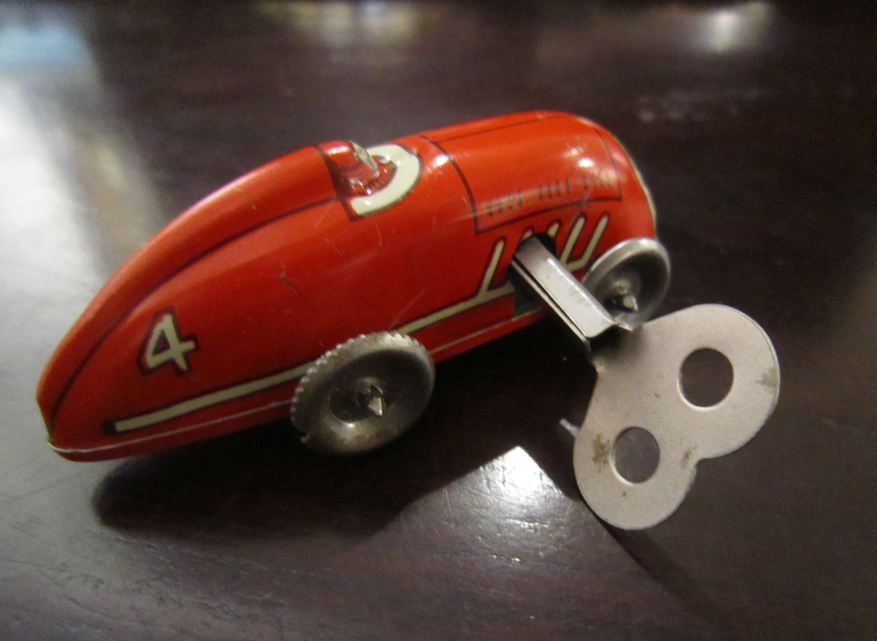
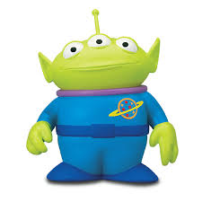
Sort the pictures of toys into old and new toys
Old toys
New toys

Slide 7
How are they different and how are they the same?
Different
The same

Slide 8
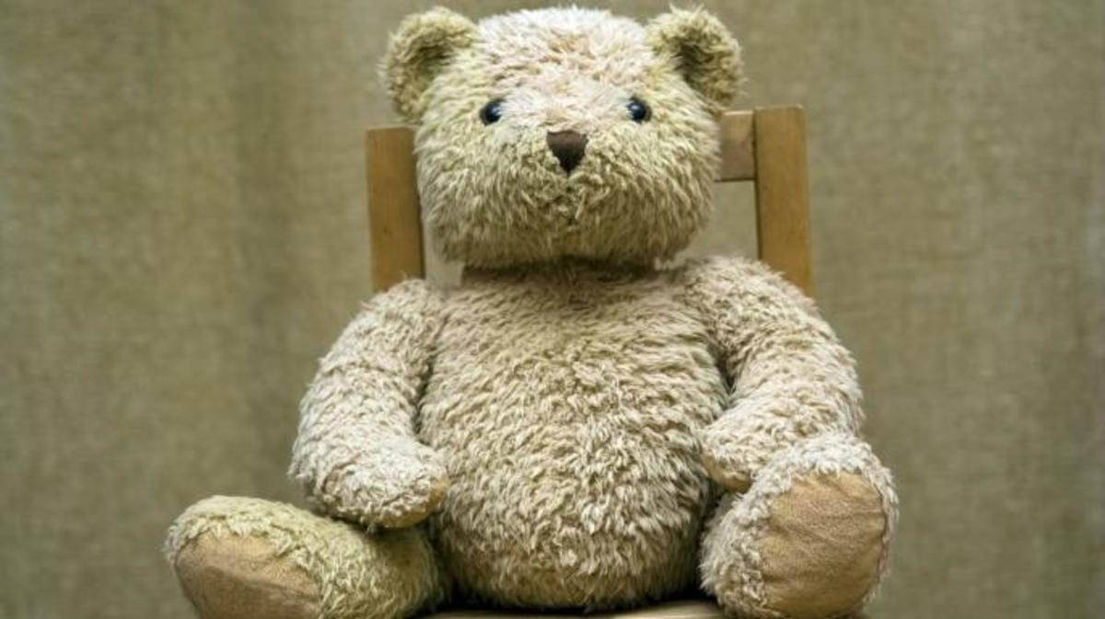
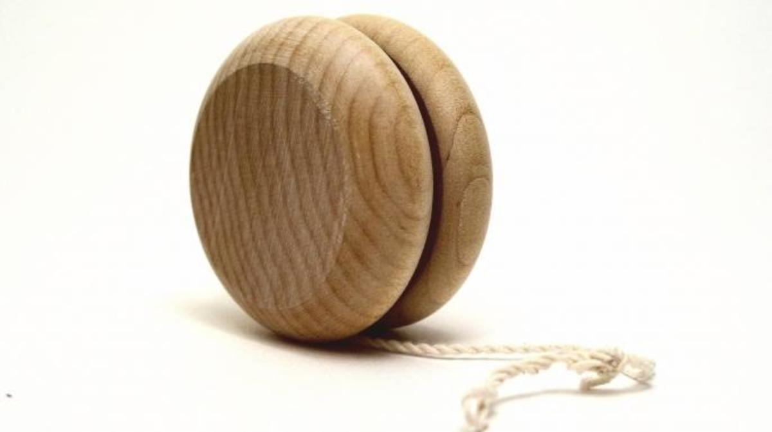
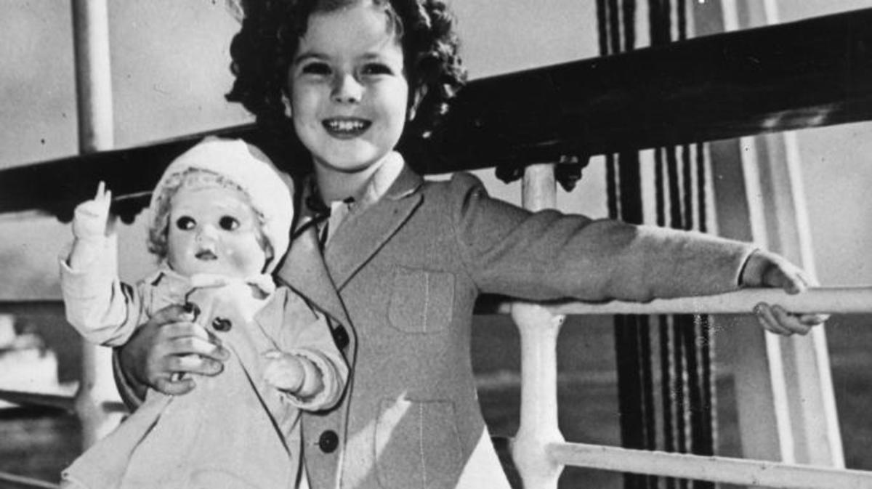
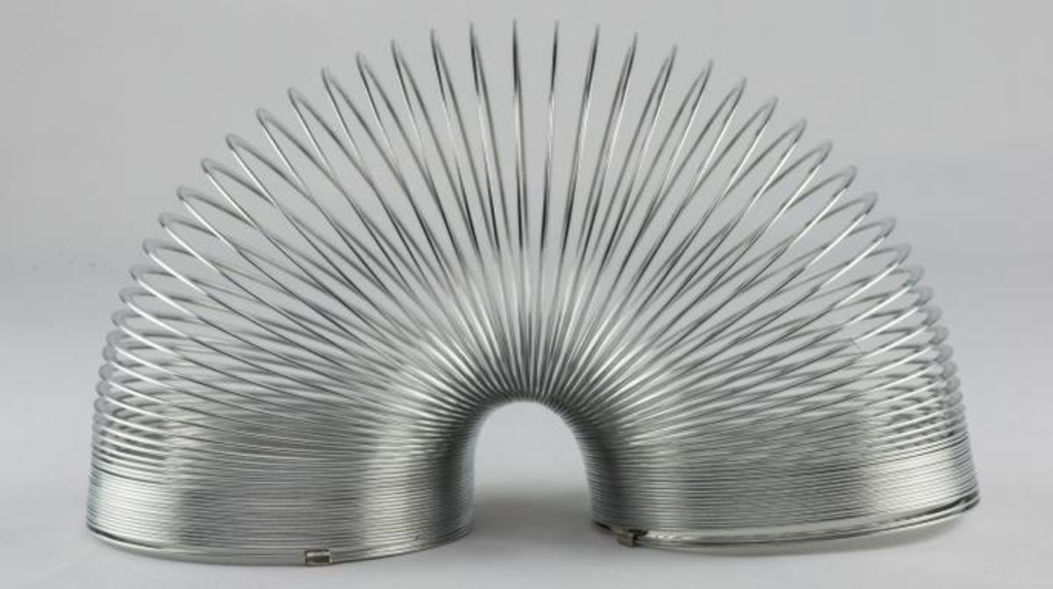
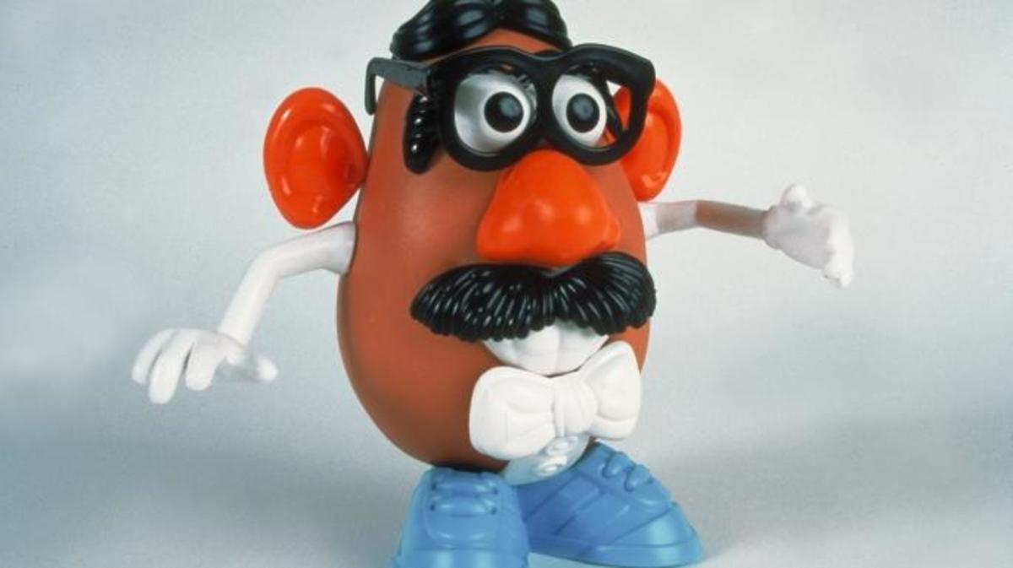
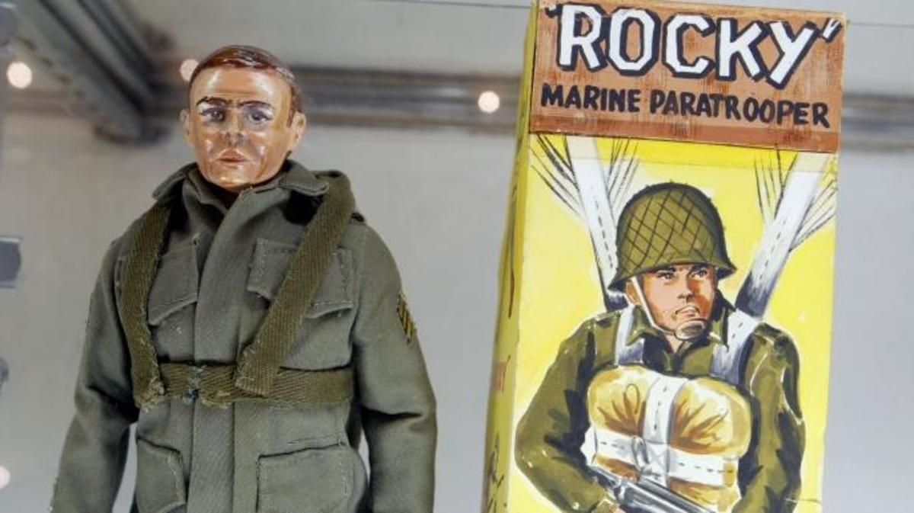
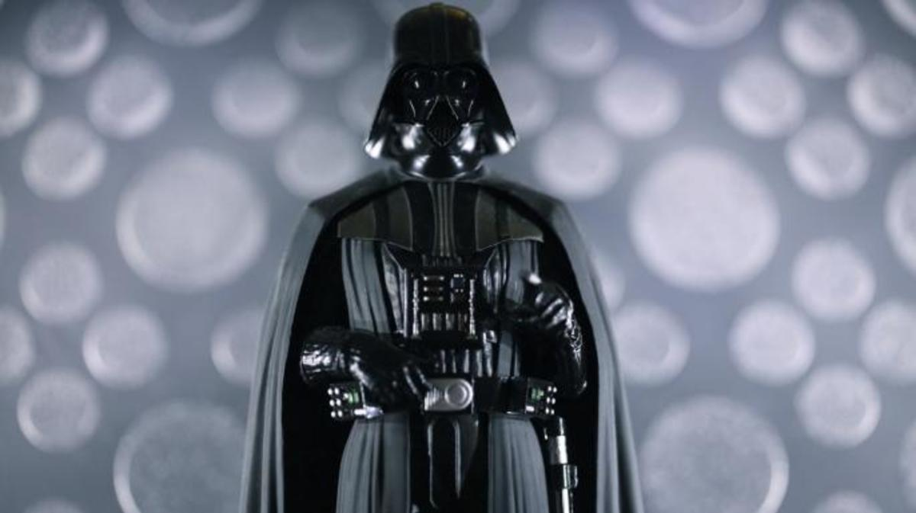
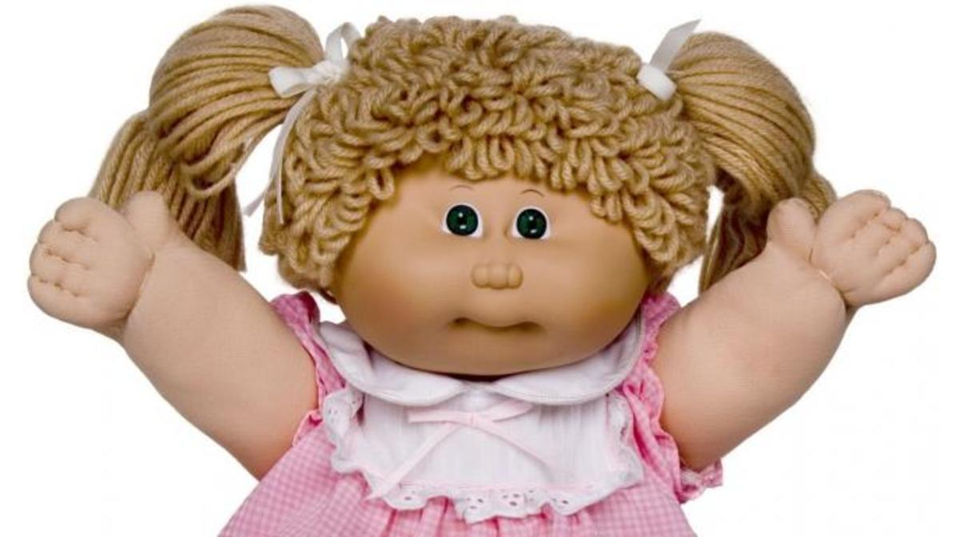
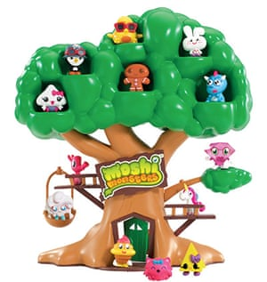
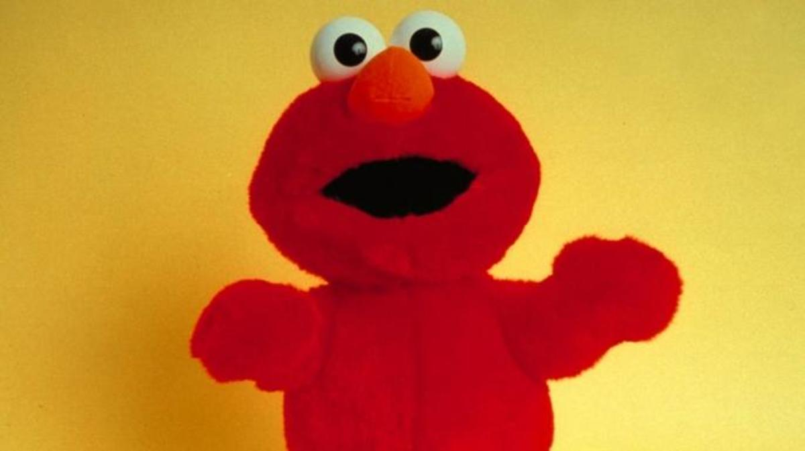
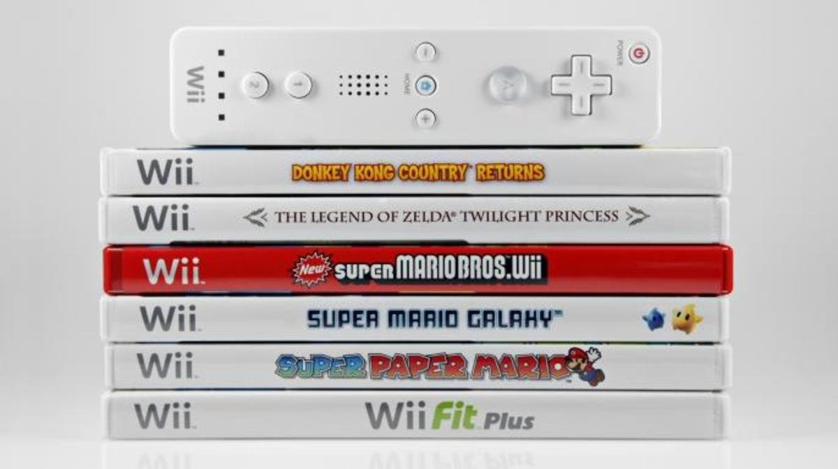
1910s Teddy Bear
1930s Shirley Temple doll
1920s Yo-yo
1940s Slinky
1950s Mr Potato Head
1960s GI Joe
1970s Star Wars action figures
1980s Cabbage Patch Kids
1990s Beanie Babies and Tickle Me Elmo
2000s Wii
2010s Moshi Monsters
Most popular Christmas toys over time: Which one would you have liked to have and why?
Source images: https://www.history.com/news/10-christmas-toys-through-the-decades

Slide 9
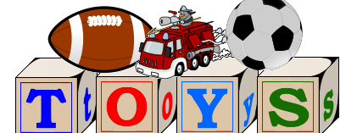
Favourite toy
What is your favourite toy and why?
What does it look like? ( shape, colour, size)
Can you draw it?
How do you play with it?

